Slide 1
DAKOFO malting barley strategy

Slide 2
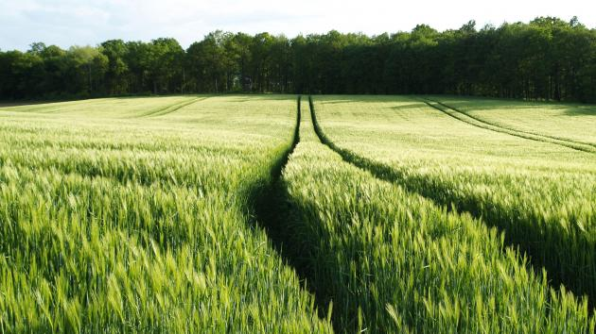
50 % increase in export of Danish malting barley
Today total Danish sales of malting barley is between 1,3 -1,5 million tons
Danish malting houses consume 0,35 million tons/year
Germany imports around 0,40 million tons/year
Other countries import 0,6 - 0,7 million tons/year

Slide 3
50 % increase in export of Danish malting barley
Global malting barley market 25 mio. tons/year
Trade: 6-8 mio. tons/year
Denmark ~ 12 % of the world trade.

Slide 4
Danish initiatives and strengths
Climatic conditions
Plant breeding
The highest certification level in the EU
Strong focus on quality
Minimizing undesirable residuals like pesticides
Traceability throughout the chain
Danish Preferred
Strong marked focus
New growth markets

Slide 5
Growth targets for the upcoming 5 years
Based on the before mentioned initiatives, a broad industry collaboration in the entire value chain could lead to an increased export of Danish malting barley
A total increase of export estimated to 50 % reaching approximately 1,5 – 1, million tons per year, based on a strict quality control through the entire production chain.
The Danish world market share of malting barley would rise from around 12 % to 16 %

