Slide 1
Quality of Danish Malting Barley

Slide 2
Why Danish malting barley?
Only two row spring varieties are grown as malting barley - Spring varieties are in general of higher malting quality compared to winter varieties.
Climatic conditions are perfect for malting barley production with low protein and optimal starch content.
Malting barley production consist of internationally recognized malt varieties.
Two plant breeding companies – Nordic Seed and SEJET Plant Breeding – are very focused in breeding of malting barley.
In Crop Innovation Denmark, CID, a strong cooperation with the danish universities take place.

Slide 3
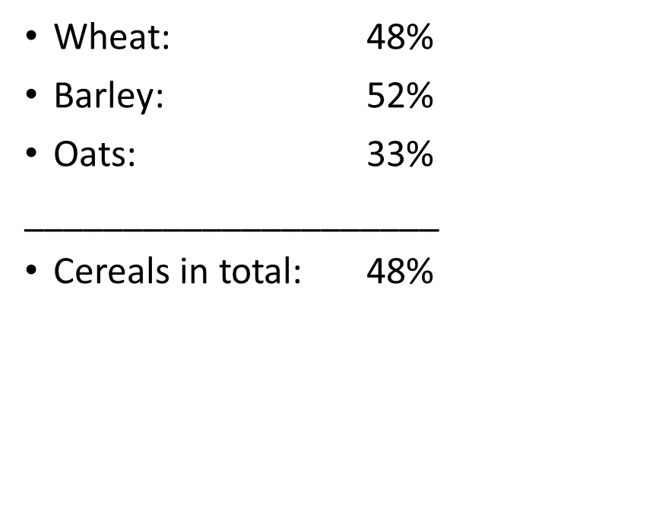
Quality of Danish malting barley
High level of certified seeds of spring barley - 95 % in 2019 – Danish farmers are contracted to use certified seeds for malting barley usage.
Danish standards for certified seed are more strict than EU and OECD Standards.
EU average Certification level
Danish Certification level for spring barley
95 %

Slide 4
Why low usage of FSS in Denmark?
Competitive and highly efficient setup of the seed business - in all steps from multiplication and processing to distribution (low costs)
Competitive and differentiated seed prices (low old, high new)
High awareness and focus on new and better varieties from farmers side
Very strong farmers advisory service – recommendations on choice of variety
Very efficient and uniform variety testing system with easy access to results (SortInfo)
Short period from harvest to sowing of winter crops

Slide 5
Why certified seeds?
Clean seed
Certified seed is grown and processed under stringent production requirements with strict limits on weeds and other crop seeds. This reduces the risk of weed seeds and plant pathogens being spread with seeds and commodities later in the value chain.
Varity purity
Certified seed produced under strictly monitored quality management systems to maximize variety purity – making sure you get the specific variety you want. Other varieties and off-types are guaranteed to be minimized – this is especially important in the malting process, as it minimizes process issues and ensuring a homogenies end-product.
Guaranteed quality assurance
Inspections in the field and at the processing plant ensure that all quality assurance requirements have been met and documented.
4. Reduced risk for pathogens
Certified seeds are screened for seed borne pathogens, which can be potentially harmful for humans and animal health.

Slide 6

Danish Preferred
- Danish approval program for Malting barley varieties.
- Danish Voice in the European malting barley sector.
- Aiming to ensure that varieties grown for malting barley production in Denmark are industrial useful for the malting industry.

Slide 7
High focus on undesired substances
Denmark have the lowest pesticide use/ha in the EU
The use of Glyphosate herbicides have been banned in malting barley since 2018 harvest
DAKOFO is monitering the glyphosate residual levels of malting barley

