Slide 1
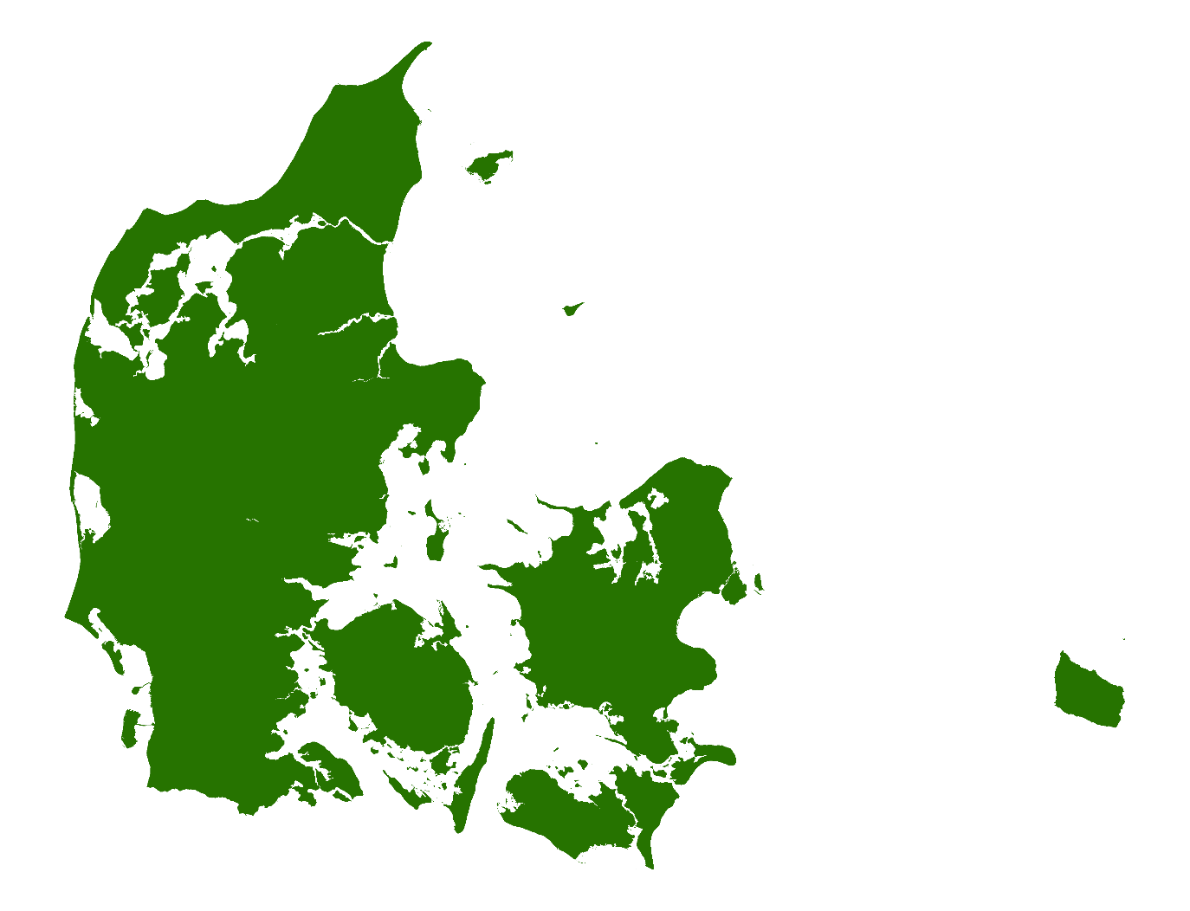
Danish Malting Barley
Destination: China

Slide 2
Production of
spring barley
Feed barley varieties
0,2 million tons
Less optimal logistics
0,8 million tons
New export markets 0,5 million tons
Total spring barley
Production 3 mio. tons
Average
malting barley sales 1,5 million tons

Slide 3
Danish malting barley
Spring barley covers normally around 20 % of the crop rotation in Denmark
Average area with spring barley is 500.000 ha.
Yield level is around 6 – 6,5 t/ha
Annual production of Danish Spring barley is around 3 million tons
*
*Seeds, Sugar beets, Silage mays, potatoes, clover grass, rape seed etc.

Slide 4
Danish malting barley
95 % of all Spring barley grown in Denmark for harvest 2019 are of malting barley varieties
Feed

Slide 5
Spring Barley production
Annually Spring barley Production around 3 million tons.
Malting barley varieties around 2,8 million tons.
Malting barley with optimal logistics is more than 2 million tons.
Average sales to maltings in Denmark and on export markets is 1,3 – 1,5 million tons.
Potential to increase – the quality is there.

Slide 6
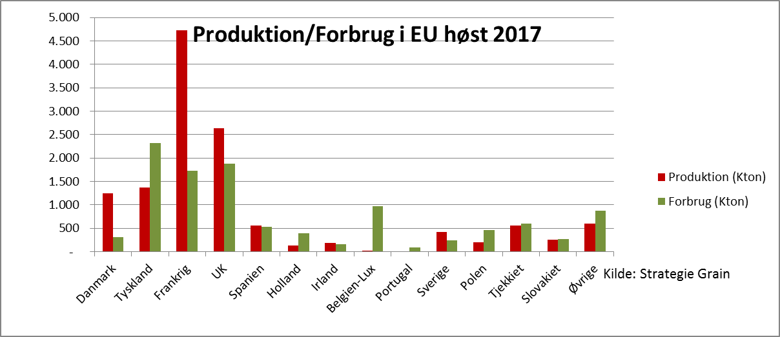
Export of malting barley
Danish malting houses uses around 350 thousand tons annually.
In most years around 75 % of the malting barley is exported.
Mainly European market as the biggest consumer, hereunder especially Germany and the Netherlands.
Shifting Oversea markets; mainly in South America.
Production/use EU average
UK
Other
Denmark
France
Spain
Ireland
Sweden
Poland
Slovakia
Germany
Portugal
The Netherlands
Belgium lux
Czech Republic
Denmark

Slide 7
Export of Danish Malting Barley
Approx. 10 million. tones of malting barley consumed in the EU per year. Of which about 7,5 t spring barley.
Denmark therefore has a market share of EU spring malt of 16%, whereas Denmark's population accounts for only 1% of the EU population.
Worldwide, annual consumption of spring and winter malt is 25 million. tons, so Denmark plays a relatively important role.

