Slide 1
PATENTER I PLANTER
efter tomat og broccoli-sagen
og efter regelændring i
EU-direktiv og ved EPO

Slide 2
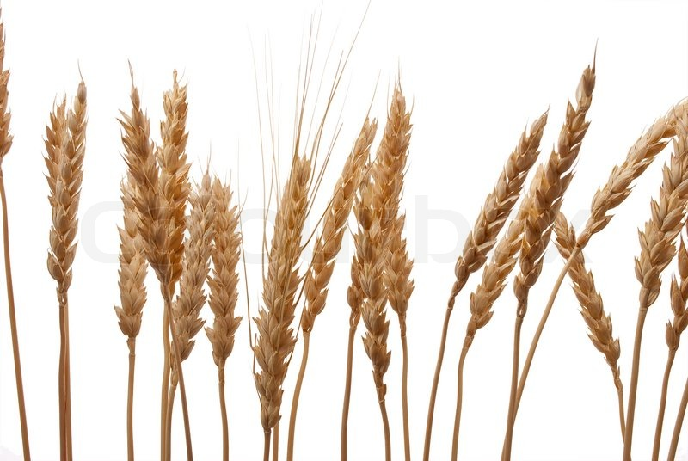
Sort 1 x Sort 2
4 patenter
19 ud af 300 planter = 6,25%

Slide 3
DIRECTIVE 98/44/EC OF THE EUROPEAN PARLIAMENT AND OF THE COUNCIL
of 6 July 1998
on the legal protection of biotechnological inventions
Article 4
1. The following shall not be patentable:
(a) plant and animal varieties;
(b) essentially biological processes for the production of plants or animals.
COMMISSION NOTICE
on certain articles of Directive 98/44/EC of the European Parliament and of the Council on the legal protection of biotechnological inventions
‘Essentially biological procedures’, i.e. crossing and selection of the whole genome …………….Patent protection is not appropriate for such procedures and their products (4).

Slide 4
The European Patent Convention
Article 53
Exceptions to patentability
European patents shall not be granted in respect of:
(b)
plant or animal varieties or essentially biological processes for the production of plants or animals; …….
EPO tilføjelse til Rule 28 (Rule 28 fortolker Artikel 53):
Exceptions to patentability:
(2) Under Article 53(b), European patents shall not be granted in respect of plants
or animals exclusively obtained by means of an essentially biological
process.

Slide 5
The European Patent Convention
55. Disclaimer
The proposal for amendment of the EPC Implementing Regulations submitted by
the Swiss delegation during the 48th meeting of the Committee on Patent Law
sets forth the following approach:
If the protection conferred by a claim extends to plants or animals exclusively obtained by an essentially biological process, a disclaimer should be added to the claim to exclude the non-patentable plants or animals. This should apply also if such a disclaimer was not disclosed in the application as filed.
Plant with a mutation in gene x, except for a plant exclusively obtained by means of an essentially biological process."

Slide 6
Melonpatentet - sammendrag
Hvem: Enza Zaden (Grønsagsforædler, Holland)
Stor patentfamilie – 10 patenter udstedt ( tre inden regelændring, syv efter)
salat, spinat, agurk, melon, løg, kål, grape, tomat, kartofler, soja
Patentkrav:
resistens mod Peronospora farinosa på baggrund af mutation i gen, der resulterer i
reduceret enzymaktivitet for DMR6-protein
Kun data for Arabidopsis: screening af homologe sekvenser reduceret DMR6 i de andre arter – GÆTVÆRK uden bevis! Dog indleveret supplerende data for spinat.
Type af mutationer: ikke beskrevet dvs. kunne være ”native traits-EBP” – fremtidigt krav til specifikation af mutation uvist.

Slide 7
Rijk Zwaan: Indsigelse aug. 2016 – appel feb. 2018
Spinatpatentet udstedt før ny regelændring – indsigelse afgjort EFTER

Slide 8
Melonpatentet - sammendrag
Under indsigelse blev Art. 53(b) og Rule 28(2) diskuteret – på trods af at der hverken beskrives hvordan mutation er fremkommet eller hvilken specifik mutation, der er tale om, skønnes det af EPO, at der ikke er konflikt med Art. 53/Rule 28. Der henvises til EPO-dokument CA/56/17.
Fremtidigt scenarie, hvor mutations-NBT kan anvendes:
Diskussion omkring ”native traits-EBP” er en PSEUDO-DISKUSSION:
hvis CRISPR-cas anføres som metode, ville al tvivl om patenterbarhed være udraderet

Slide 9
Er mutagenese i virkeligheden en ”Essentiel biologisk proces” og dermed undtaget fra patentering
Mutationer sker konstant i naturen – alle gener er på et tidspunkt muteret
Opfindelse eller opdagelse?
Generne er der allerede – et klip ændrer ikke substantielt på tingenes tilstand.
Copa Cogeca Working Party Seeds

